Slide 1



We will be starting shortly
Join the discord to stay up to date on all our events!

Slide 2
Welcome to
STAT 230 Midterm Review
Brought to you by STAT Club and Math Soc!

Slide 3
Discrete Random Variables
Random Variable – A function that assigns a point in a sample space to a set real number
Discrete Random Variables – The set of real numbers is countable
Continuous Random Variable – The set of real numbers is countably infinite

Slide 4
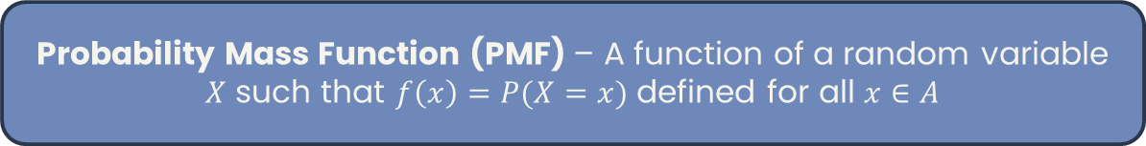
Probability Mass Function
Probability Mass Function (PMF) – A function of a random variable $X$ such that $f\left(x\right)=P(X=x)$ defined for all $x∈A$
1
Determine the random variable
Determine the probability distribution (the set $\{\left(x,f\left(x\right)\right):x∈A\}$)
2
3
Compute the PMF (create a function if necessary)

Slide 5

Cumulative Distribution Function
Cumulative Distribution Function (CDF) – A function of a random variable $X$ such that $F\left(x\right)=P(X≤x)$ defined for all $x∈A$
$0≤F\left(x\right)≤1$ for $x∈ℝ$
$F(x)$ is non-decreasing over $x∈ℝ$
$$\lim_{h→0^{+}}{f\left(x+h\right)=F(x)}$$
$\lim_{x→−∞}{F\left(x\right)=0}$ and $\lim_{x→∞}{F\left(x\right)=1}$

Slide 6
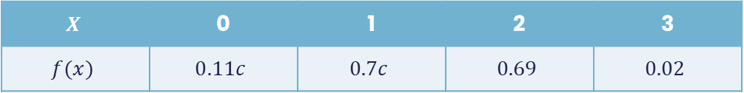
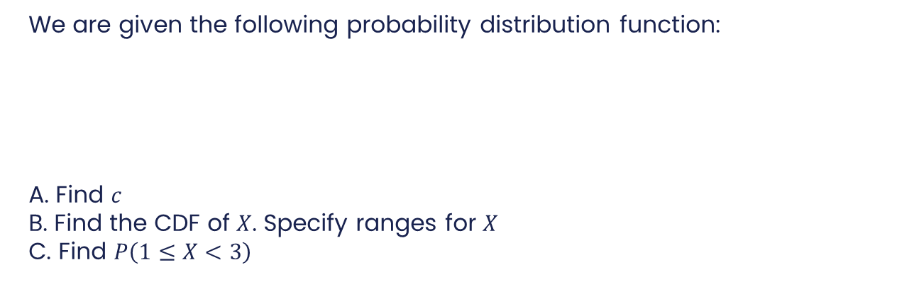
Probability Mass & Distribution - Example
We are given the following probability distribution function:
A. Find $c$
B. Find the CDF of $X$. Specify ranges for $X$
C. Find $P\left(1≤X<3\right)$
$$X$$ | 0 | 1 | 2 | 3
$$f(x)$$ | $$0.11c$$ | $$0.7c$$ | $$0.69$$ | $$0.02$$

Slide 7
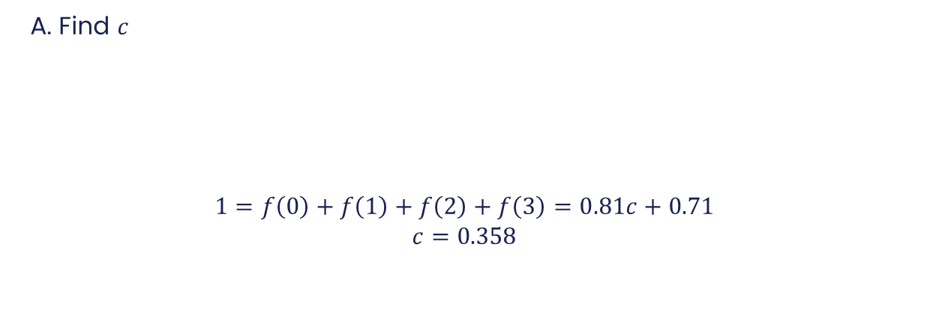
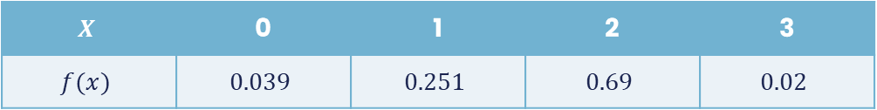
Probability Mass & Distribution - Example
A. Find $c$
$$1=f\left(0\right)+f\left(1\right)+f\left(2\right)+f\left(3\right)=0.81c+0.71$$
$$c=0.358$$
$$X$$ | 0 | 1 | 2 | 3
$$f(x)$$ | $$0.11c$$ | $$0.7c$$ | $$0.69$$ | $$0.02$$
$$X$$ | 0 | 1 | 2 | 3
$$f(x)$$ | $$0.039$$ | $$0.251$$ | $$0.69$$ | $$0.02$$

Slide 8
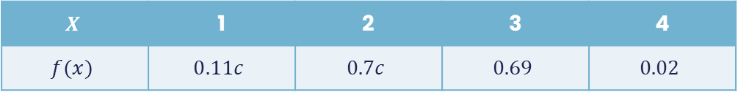

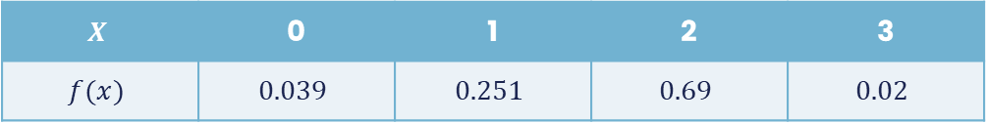
Probability Mass & Distribution - Example
B. Find the CDF of $X$. Specify ranges for $X$
$$F\left(X\right)=\left\{\begin{aligned}0, x<0 \\ &0.039, 0≤x<1 \\ 0.29, 1≤x<2 \\ 0.98, 2≤x<3 \\ 1, x≥3\end{aligned}\right.$$
$$X$$ | 1 | 2 | 3 | 4
$$f(x)$$ | $$0.11c$$ | $$0.7c$$ | $$0.69$$ | $$0.02$$
$$X$$ | 0 | 1 | 2 | 3
$$f(x)$$ | $$0.039$$ | $$0.251$$ | $$0.69$$ | $$0.02$$

Slide 9

Probability Mass & Distribution - Example
C. Find $P\left(1≤X<3\right)$
$$P\left(1≤X<3\right)=P\left(X=1\right)+P\left(X=2\right)=0.251+0.69=0.941$$
$$X$$ | 1 | 2 | 3 | 4
$$f(x)$$ | $$0.11c$$ | $$0.7c$$ | $$0.69$$ | $$0.02$$
$$X$$ | 0 | 1 | 2 | 3
$$f(x)$$ | $$0.039$$ | $$0.251$$ | $$0.69$$ | $$0.02$$

Slide 10
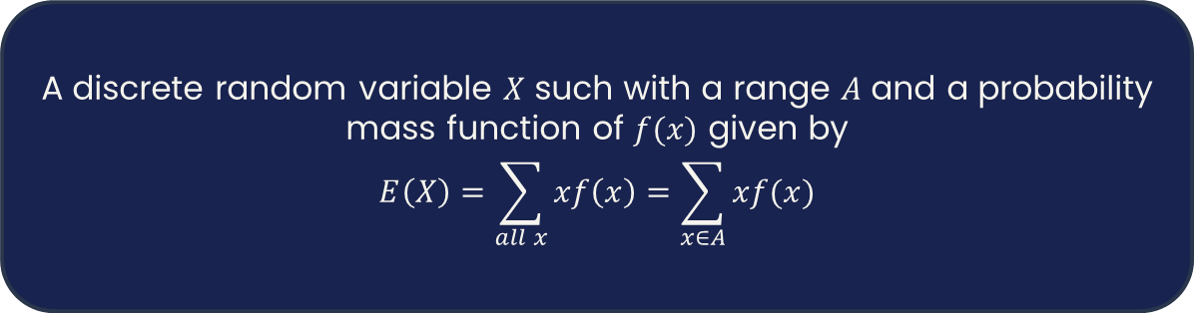
Expected Value Function
Expected Value Function – Represents the weighted average or the expectation of a discrete random variable $X$
A discrete random variable $X$ such with a range $A$ and a probability mass function of $f(x)$ given by
$$E\left(X\right)=\sum_{all x}{xf\left(x\right)=\sum_{x∈A}{xf(x)}}$$

Slide 11
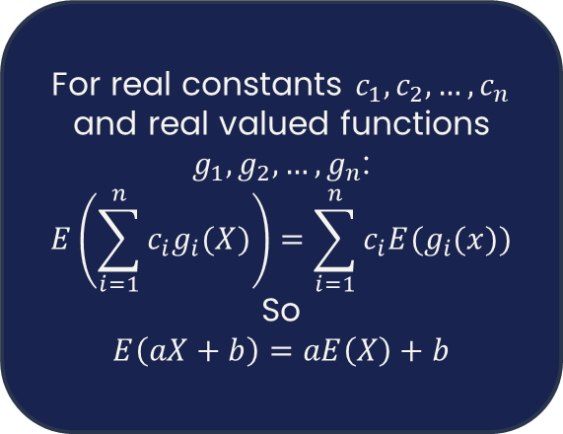
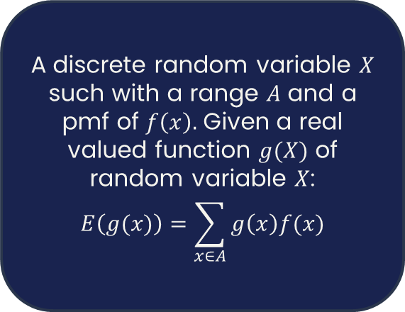
Expected Value Function - Theorems
A discrete random variable $X$ such with a range $A$ and a pmf of $f\left(x\right).$ Given a real valued function $g(X)$ of random variable $X$:
$$E\left(g(x)\right)=\sum_{x∈A}{g\left(x\right)f(x)}$$
For real constants $c_{1},c_{2},…,c_{n}$ and real valued functions $g_{1},g_{2},…,g_{n}$:
$$E\left(\sum_{i=1}^{n}{c_{i}g_{i}(X)}\right)=\sum_{i=1}^{n}{c_{i}E(g_{i}(x)})$$
So
$$E\left(aX+b\right)=aE\left(X\right)+b$$

Slide 12
Expected Value Function - Example
A lottery has printed 3,000,000 tickets. These tickets are sold for $4. Of these, the following prizes were given out at and the following frequency.
Find the net winnings of the lottery ticket
Find the net winnings of the lottery that is not a part of the largest 10 prize winners
Find the net winnings of the lottery of a winning ticket
Prize($) | 35,000 | 1,000 | 100 | 20 | 10 | 8 | 4 | 2
Frequency | 4 | 6 | 150 | 22,000 | 16,000 | 80,000 | 160,000 | 300,000

Slide 13

Expected Value Function - Example
A. Find the net winnings of a lottery ticket
Prize($) | 35,000 | 1,000 | 100 | 20 | 10 | 8 | 4 | 2
Frequency | 4 | 6 | 150 | 22,000 | 16,000 | 80,000 | 160,000 | 300,000
1
Determine the expected value of the winnings for a lottery ticket
$$E\left(x\right)=140000+6000+15000+440000+160000+640000+640000+600000$$
Divide the expected value by the number of tickets
2
$$\frac{E\left(x\right)}{3000000}=0.8803333$$
3
Subtract the cost of the ticket
$$0.88033333−4=−3.11966666$$

Slide 14

Expected Value Function - Example
B. Find the net winnings of the lottery that is not a part of the largest 10 prize winners
Prize($) | 35,000 | 1,000 | 100 | 20 | 10 | 8 | 4 | 2
Frequency | 4 | 6 | 150 | 22,000 | 16,000 | 80,000 | 160,000 | 300,000
1
Determine the expected value of the winnings for a lottery ticket
$$E\left(x\right)=15000+440000+160000+640000+640000+600000$$
Divide the expected value by the number of tickets
2
$$\frac{24950000}{3000000}=0.8316666$$
3
Subtract the cost of the ticket
$$0.83166666−4=−3.168333$$

Slide 15


Expected Value Function - Example
C. Find the net winnings of the lottery of a winning ticket
Prize($) | 35,000 | 1,000 | 100 | 20 | 10 | 8 | 4 | 2
Frequency | 4 | 6 | 150 | 22,000 | 16,000 | 80,000 | 160,000 | 300,000
1
Determine the expected value of the winnings for a lottery ticket
$$E\left(x\right)=140000+6000+15000+440000+160000+640000+640000+600000$$
Divide the expected value by the number of winning tickets
2
$$\frac{E(x)}{578160}=4.5679$$
3
Subtract the cost of the ticket
$$4.5679−4=0.5679$$

Slide 16

Variance
Variance – $Var\left(X\right)=σ^{2}=E\left({\left(x−μ\right)}^{2}\right)$
1
$$Var\left(X\right)=E\left(X^{2}\right)−μ^{2}$$
$$Var\left(X\right)=σ^{2}=E\left(X\left(X−1\right)\right)+μ−μ^{2}$$
2
3
$$Var\left(aX+b\right)=a^{2}Var(X)$$

Slide 17

Standard Deviation
Standard Deviation – $σ=SD\left(X\right)=\sqrt{Var(X)}=\sqrt{E\left({\left(x−μ\right)}^{2}\right)}$
1
$$σ=\sqrt{E\left(X^{2}\right)−μ^{2}}$$
$$σ=\sqrt{E\left(X\left(X−1\right)\right)+μ−μ^{2}}$$
2
3
$$SD\left(aX+b\right)=\left|a\right|SD(X)$$

Slide 18
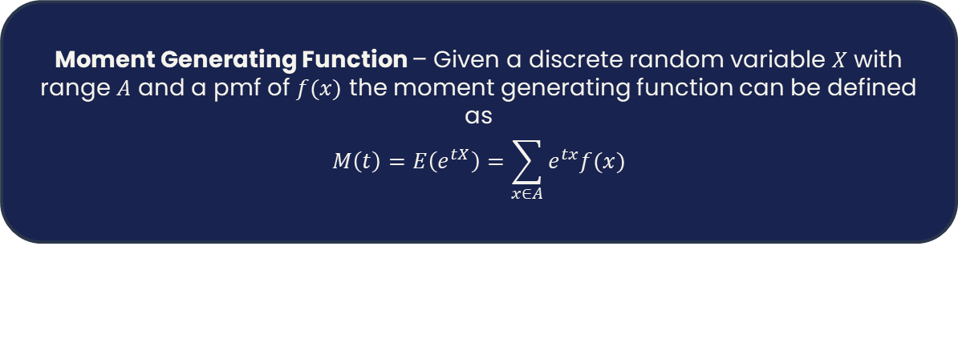
Moment Generating Function
Moment Generating Function – Given a discrete random variable $X$ with range $A$ and a pmf of $f(x)$ the moment generating function can be defined as
$$M\left(t\right)=E\left(e^{tX}\right)=\sum_{x∈A}{e^{tx}f(x)}$$

Slide 19
Proabability Distributions

Slide 20
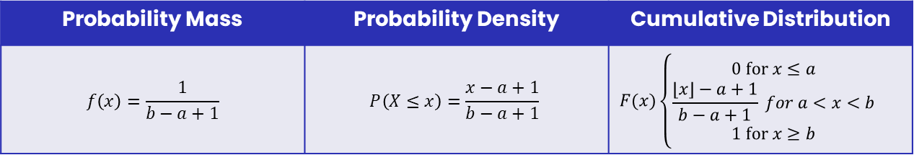

Discrete Uniform Distribution
Physical Setup: A random variable $X$ which takes values from the set $A=\{a,a+1,…,b−1,b\}$ where $a≤b$
Probability Mass | Probability Density | Cumulative Distribution
$$f\left(x\right)=\frac{1}{b−a+1}$$ | $$P\left(X≤x\right)=\frac{x−a+1}{b−a+1}$$ | $$F(x)\left\{\begin{aligned}0 \text{for} x≤a \\ \frac{\left\lfloor x\right\rfloor −a+1}{b−a+1} for a<x<b \\ 1 \text{for} x≥b\end{aligned}\right.$$
Expectation Function | Variance Function
$$E\left(X\right)=\frac{b+a}{2}$$ | $$Var\left(X\right)=\frac{(b−a)(b−a+2)}{12}$$
Example. Rolling a 1 on a fair dice or drawing a number from 49 random numbers

Slide 21

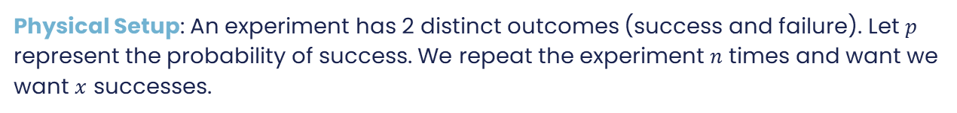
Binomial Distribution
Physical Setup: An experiment has 2 distinct outcomes (success and failure). Let $p$ represent the probability of success. We repeat the experiment $n$ times and want we want $x$ successes.
Probability Mass Function | Moment Generating Function
$$f\left(x\right)=\left({n \atop x}\right)p^{x}{\left(1−p\right)}^{n−x}$$ | $$M\left(t\right)={\left(pe^{t}+1−p\right)}^{n},t∈ℝ$$
Expectation Function | Variance Function
$$E\left(X\right)=np$$ | $$Var\left(X\right)=np(1−p)$$
Example. What’s the chance of rolling a 6, 2 times when rolling a fair dice 10 times

Slide 22

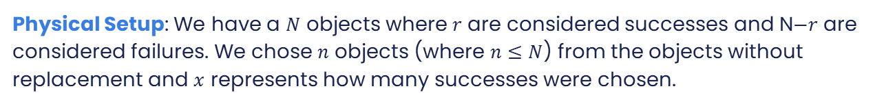

Hypergeometric Distribution
Physical Setup: We have a $N$ objects where $r$ are considered successes and N$−r$ are considered failures. We chose $n$ objects (where $n≤N$) from the objects without replacement and $x$ represents how many successes were chosen.
Probability Mass Function
$$f\left(x\right)=\frac{\left({n \atop x}\right)\left({N−r \atop n−x}\right)}{\left({N \atop n}\right)}$$
Expectation Function | Variance Function
$$E\left(X\right)=\frac{nr}{N}$$ | $$Var\left(X\right)=\frac{nr(N−r)(N−n)}{N^{2}(N−1)}$$
Example. If five cards are randomly dealt from a standard deck of 52 playing cards and we want to know the number of diamond cards drawn

Slide 23
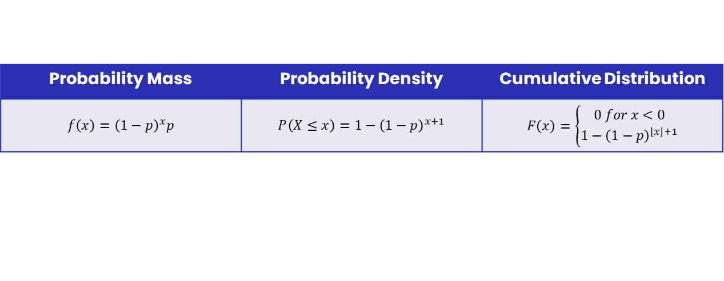
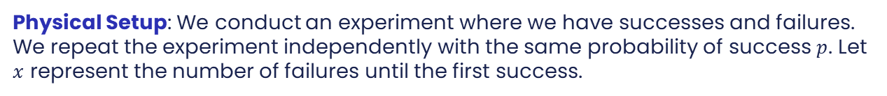

Geometric Distribution
Physical Setup: We conduct an experiment where we have successes and failures. We repeat the experiment independently with the same probability of success $p$. Let $x$ represent the number of failures until the first success.
Probability Mass | Probability Density | Cumulative Distribution
$$f\left(x\right)={\left(1−p\right)}^{x}p$$ | $$P\left(X≤x\right)=1−{\left(1−p\right)}^{x+1}$$ | $$F\left(x\right)=\left\{\begin{aligned}0 for x<0 \\ 1−{\left(1−p\right)}^{\left\lfloor x\right\rfloor +1}\end{aligned}\right.$$
Expectation Function | Variance Function
$$E\left(X\right)=\frac{1−p}{p}$$ | $$Var\left(X\right)=\frac{1−p}{p^{2}}$$
Example. If the probability you win a lottery prize in any given week is 0.05 and we want to count the number of weeks before you win a prize for the first time

Slide 24
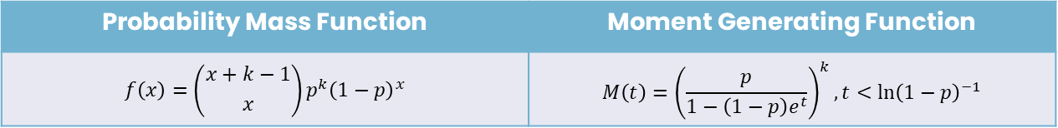
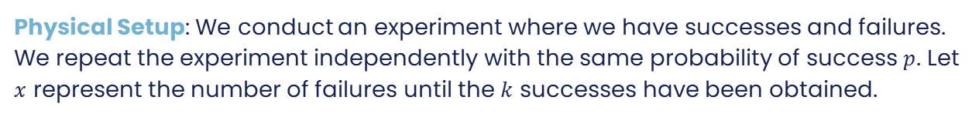

Negative Binomial Distribution
Physical Setup: We conduct an experiment where we have successes and failures. We repeat the experiment independently with the same probability of success $p$. Let $x$ represent the number of failures until the $k$ successes have been obtained.
Probability Mass Function | Moment Generating Function
$$f\left(x\right)=\left({x+k−1 \atop x}\right)p^{k}{\left(1−p\right)}^{x}$$ | $$M\left(t\right)={\left(\frac{p}{1−\left(1−p\right)e^{t}}\right)}^{k},t<{\ln\left(1−p\right)}^{−1}$$
Expectation Function | Variance Function
$$E\left(X\right)=\frac{k\left(1−p\right)}{p}$$ | $$Var\left(X\right)=\frac{k\left(1−p\right)}{p^{2}}$$
Example. If a fair coin is tossed until we get the sixth head and we want to know the probability we obtain 3 failures

Slide 25


Poisson Distribution
Physical Setup: The same as a binomial distribution BUT we are given a constant mean ($μ=np)$
Probability Mass Function | Moment Generating Function
$$f\left(x\right)=\frac{μ^{x}e^{−μ}}{x!}$$ | $$M\left(t\right)=e^{μ(e^{t}−1)},t∈ℝ$$
Expectation Function | Variance Function
$$E\left(X\right)=μ$$ | $$Var\left(X\right)=\frac{nr(N−r)(N−n)}{N^{2}(N−1)}$$

Slide 26
Multivariate Discrete Probabilities

Slide 27

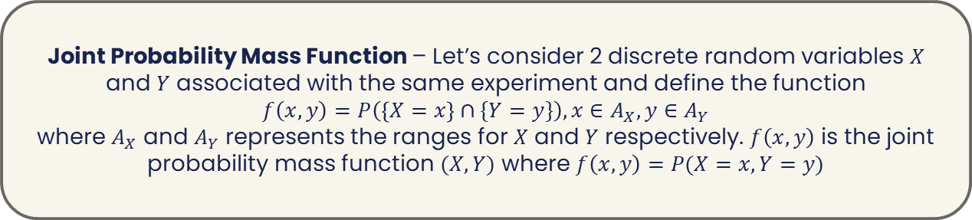
Joint Probability Mass Function
Joint Probability Mass Function – Let’s consider 2 discrete random variables $X$ and $Y$ associated with the same experiment and define the function
$$f\left(x,y\right)=P\left(\left\{X=x\right\}∩\{Y=y\}\right), x∈A_{X}, y∈A_{Y}$$
where $A_{X}$ and $A_{Y}$ represents the ranges for $X$ and $Y$ respectively. $f\left(x,y\right)$ is the joint probability mass function $(X,Y)$ where $f\left(x,y\right)=P(X=x,Y=y)$
Marginal PMF – You can derive the PMF of a random variable in a joint PMF!
Example. $P\left(X=0\right)=P\left(X=0,Y=1\right)+P(X=0,Y=2)$

Slide 28
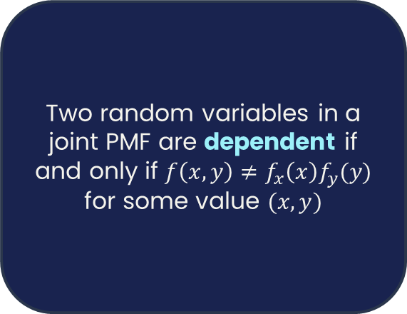
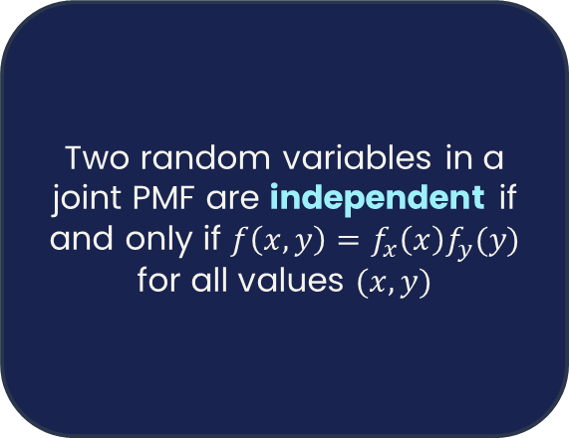
Independent and Dependent Random Variables
Two random variables in a joint PMF are independent if and only if $f\left(x,y\right)=f_{x}\left(x\right)f_{y}(y)$ for all values $(x,y)$
Two random variables in a joint PMF are dependent if and only if $f\left(x,y\right)≠f_{x}\left(x\right)f_{y}(y)$ for some value $(x,y)$

Slide 29

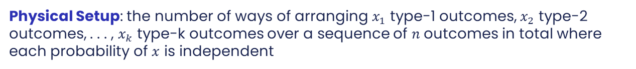
Multinomial Distribution
Physical Setup: the number of ways of arranging $x_{1}$ type-1 outcomes, $x_{2}$ type-2 outcomes, . . . , $x_{k}$ type-k outcomes over a sequence of $n$ outcomes in total where each probability of $x$ is independent
Probability Mass Function
$$f\left(x_{1},x_{2},…,x_{k}\right)=\frac{n!}{x_{1}!x_{2}!…x_{k}!}p_{1}^{x_{1}}p_{2}^{x_{2}}…p_{k}^{x_{k}}$$
Example. Consider an experiment in which three fair dice are tossed. In ten independent tosses, let X be the number of times all three faces are alike and let Y be the number of times only two faces are alike.

Slide 30
Multivariate Discrete Probabilities - Example
Making lemonade requires lemons, sugar, and water. Good lemonade has a balance between sour (lemons) and sweet (sugar). If there are more lemons than sugar, it will be too sour, and if there is more sugar than lemons, it will be too sweet. Suppose you make 9 glasses of lemonade, where the distribution of the number of lemons, X, and the number of sugar cubes, Y, is given by the following joint probability function:
F(x,y) | X=0 | X=1 | X=2
Y=0 | 0.05 | 0.05 | 0.05
Y=1 | 0.05 | 0.25 | 0.05
Y=2 | 0.1 | 0.05 | 0.35

Slide 31
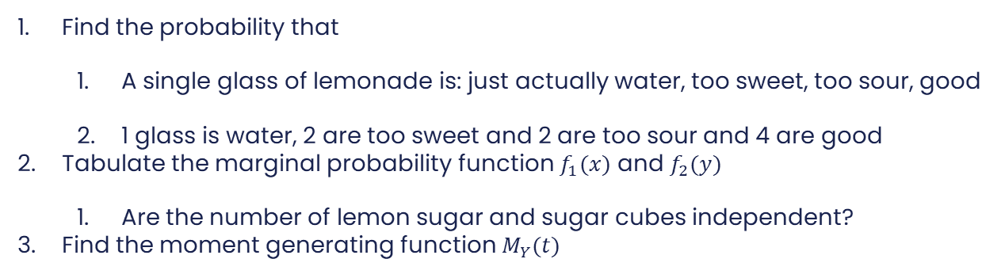
Multivariate Discrete Probabilities - Example
Find the probability that
  A single glass of lemonade is: just actually water, too sweet, too sour, good
  1 glass is water, 2 are too sweet and 2 are too sour and 4 are good
Tabulate the marginal probability function $f_{1}(x)$ and $f_{2}(y)$
  Are the number of lemon sugar and sugar cubes independent?
Find the moment generating function $M_{Y}(t)$

Slide 32
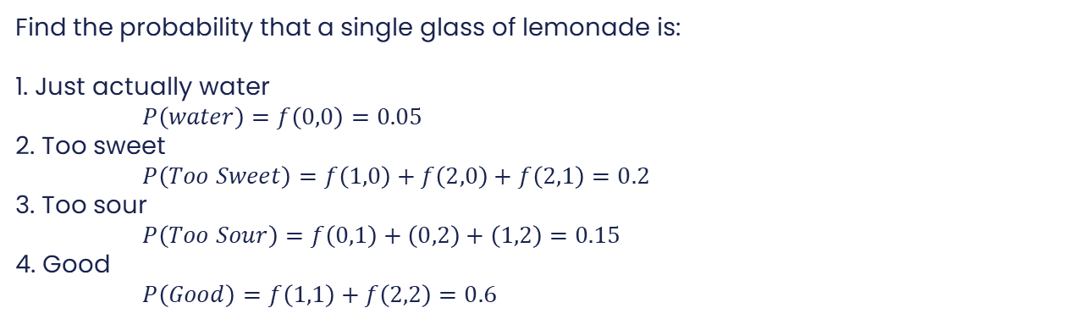
Multivariate Discrete Probabilities - Example
Find the probability that a single glass of lemonade is:
1. Just actually water
$P\left(water\right)=f\left(0,0\right)=0.05$
2. Too sweet
$P\left(Too Sweet\right)=f\left(1,0\right)+f\left(2,0\right)+f\left(2,1\right)=0.2$
3. Too sour
$P\left(Too Sour\right)=f\left(0,1\right)+\left(0,2\right)+\left(1,2\right)=0.15$
4. Good
$P\left(Good\right)=f\left(1,1\right)+f\left(2,2\right)=0.6$
F(x,y) | X=0 | X=1 | X=2
Y=0 | 0.05 | 0.05 | 0.05
Y=1 | 0.05 | 0.25 | 0.05
Y=2 | 0.1 | 0.05 | 0.35

Slide 33

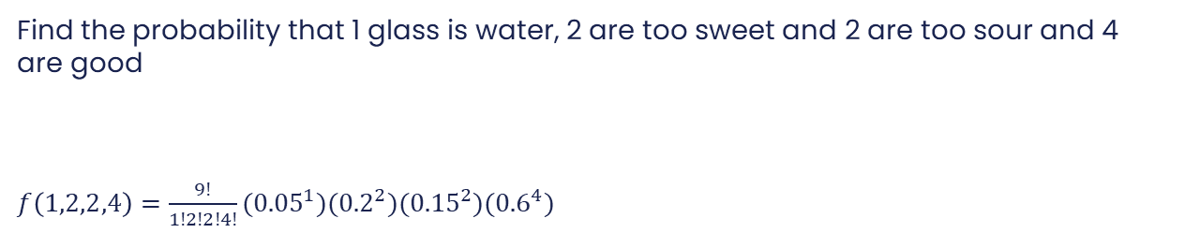
Multivariate Discrete Probabilities - Example
  Find the probability that 1 glass is water, 2 are too sweet and 2 are too sour and 4 are good
  $f\left(1,2,2,4\right)=\frac{9!}{1!2!2!4!}({0.05}^{1})({0.2}^{2})({0.15}^{2})({0.6}^{4})$
F(x,y) | X=0 | X=1 | X=2
Y=0 | 0.05 | 0.05 | 0.05
Y=1 | 0.05 | 0.25 | 0.05
Y=2 | 0.1 | 0.05 | 0.35
$$f\left(x_{1},x_{2},…,x_{k}\right)=\frac{n!}{x_{1}!x_{2}!…x_{k}!}p_{1}^{x_{1}}p_{2}^{x_{2}}…p_{k}^{x_{k}}$$

Slide 34
Multivariate Discrete Probabilities - Example
Tabulate the marginal probability function $f_{1}(x)$ and $f_{2}(y)$. Are X and Y independent?
F(x,y) | X=0 | X=1 | X=2
Y=0 | 0.05 | 0.05 | 0.05
Y=1 | 0.05 | 0.25 | 0.05
Y=2 | 0.1 | 0.05 | 0.35
 | X=0 | X=1 | X=2
F(x)
 | Y=0 | Y=1 | Y=2
F(y) | 0.15 | 0.35 | 0.5
 | X=0 | X=1 | X=2
F(x) | 0.2 | 0.35 | 0.45
 | Y=0 | Y=1 | Y=2
F(y)
They are not independent

Slide 35
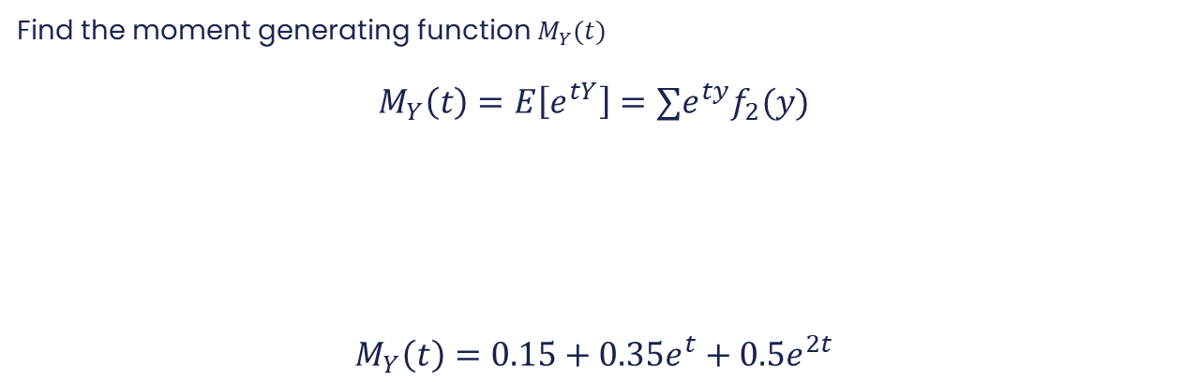
Multivariate Discrete Probabilities - Example
Find the moment generating function $M_{Y}(t)$
$$M_{Y}\left(t\right)=E\left[e^{tY}\right]=∑e^{ty}f_{2}(y)$$
$$M_{Y}\left(t\right)=0.15+0.35e^{t}+0.5e^{2t}$$
 | Y=0 | Y=1 | Y=2
F(y) | 0.15 | 0.35 | 0.5

